Slide 1
Software Testing Project1 Continuous Integration
Tutorial
Junit + Github + Jenkins+JaCoCo
Instructor: 王凡教授
TA: 鄭大容
Email: R06943080@ntu.edu.tw

Slide 2
Unit Test
對於程式碼中的單元如class, method進行測試的方法。
對於大型專案的單元測試，已有現成的IDE工具可供使用。
Ex. Eclipse

Slide 3
What is CI?
Continuous integration is the method used to determine that the entire system is in the running state and the changes made have not lead to errors in some parts of the system.

Slide 4
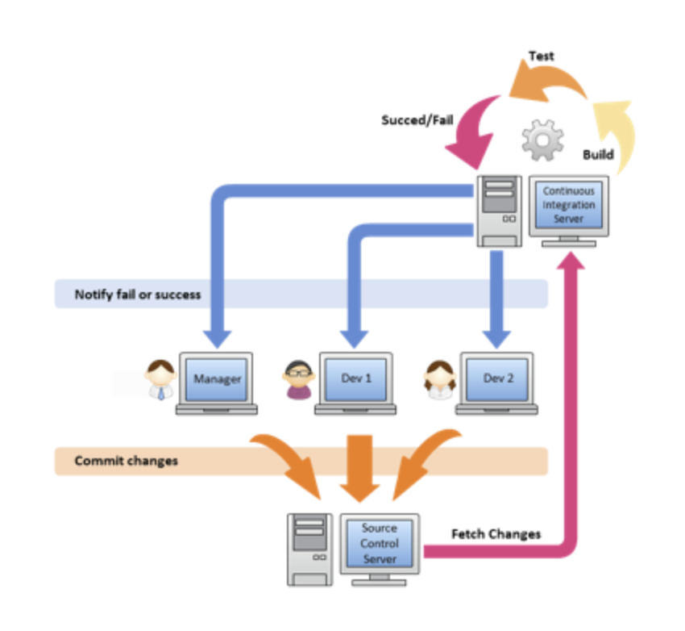
How CI works?

Slide 5
What is Jenkins?
An open source continuous integration and build automation tool
Helps automate tasks:
Building
Testing
Deploying

Slide 6
Goals
Create a Java project
Use an external library. (ex. Sort)
Writing testcases for this project
Create a public repo and push your work to Github
Setup Jenkins server
Automatic fetch and build your java project from Github on Jenkins
Coverage report with JaCoCo plugin
Find an external library and design your testcases

Slide 7
Prerequisite
Ubuntu 16.04
This tutorial was written and tested on Ubuntu 16.04
There might be some difference if you use other OS.
Install Java SE 8 first
For Ubuntu
sudo add-apt-repository ppa:webupd8team/java
sudo apt-get update
sudo apt-get install oracle-java8-installer
Eclipse IDE

Slide 8
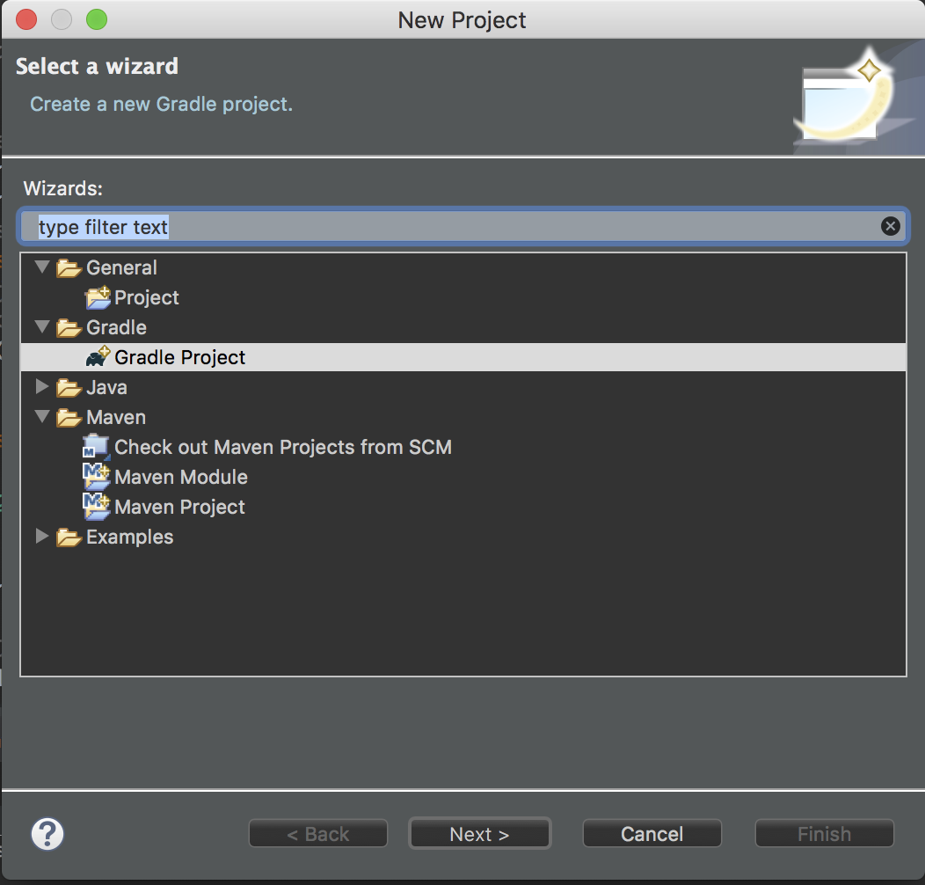
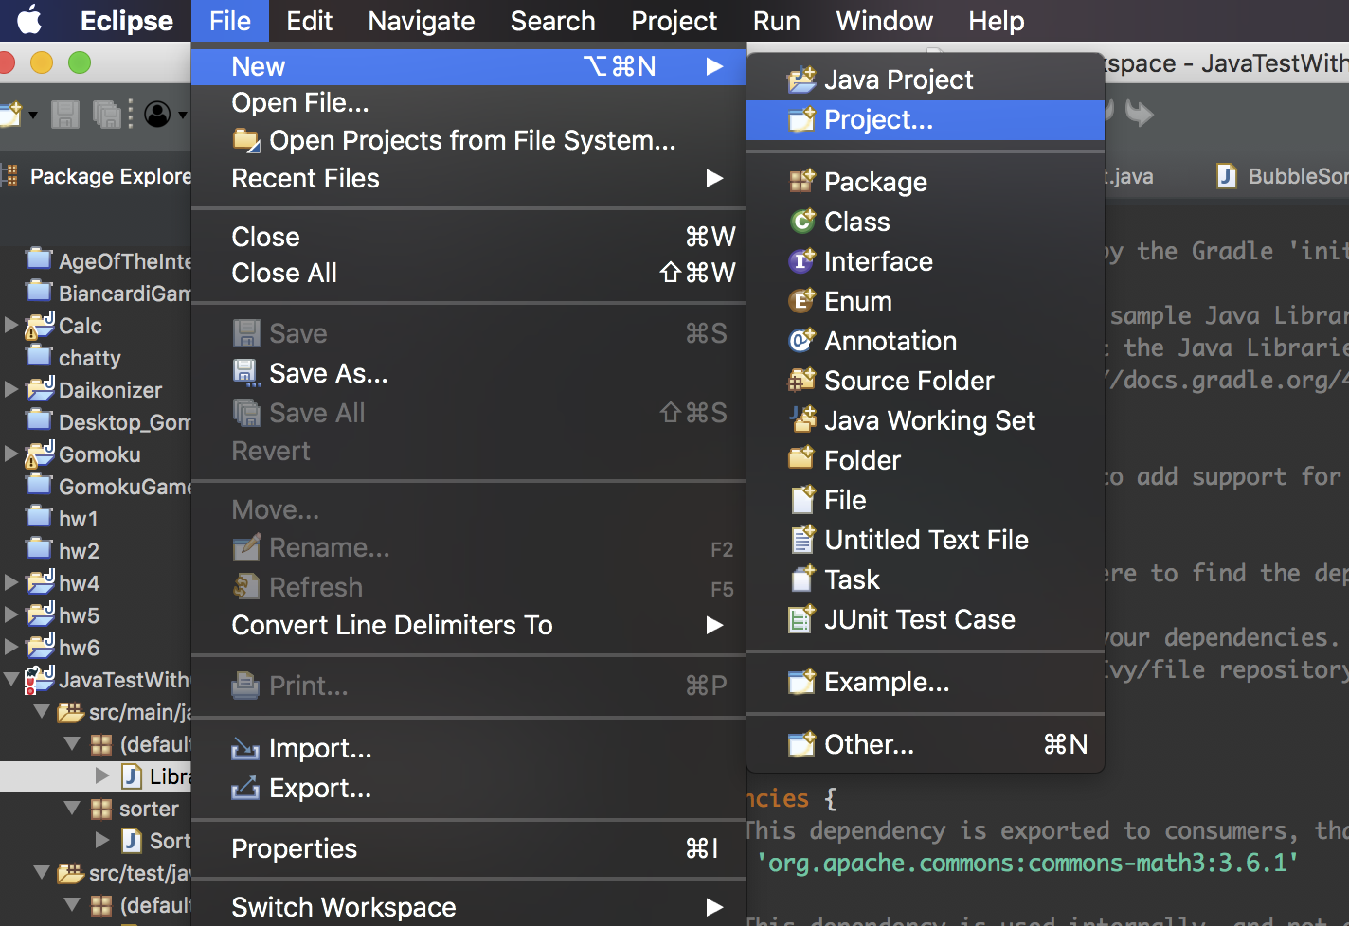
Goal 1: Create a Java project
We use eclipse for demo:
Download here: https://www.eclipse.org/downloads/packages/release/2018-09/r/eclipse-ide-java-developers
We’ll be using Gradle to manage our Java project
File >> New >> Project >> Select Gradle Project

Slide 9
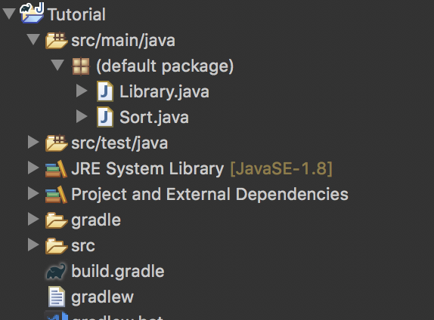
Goal 2: Use an external library
In our demo:
We use a sort algorithm library: LINK
Drag & Drop the file into src/main/java

Slide 10
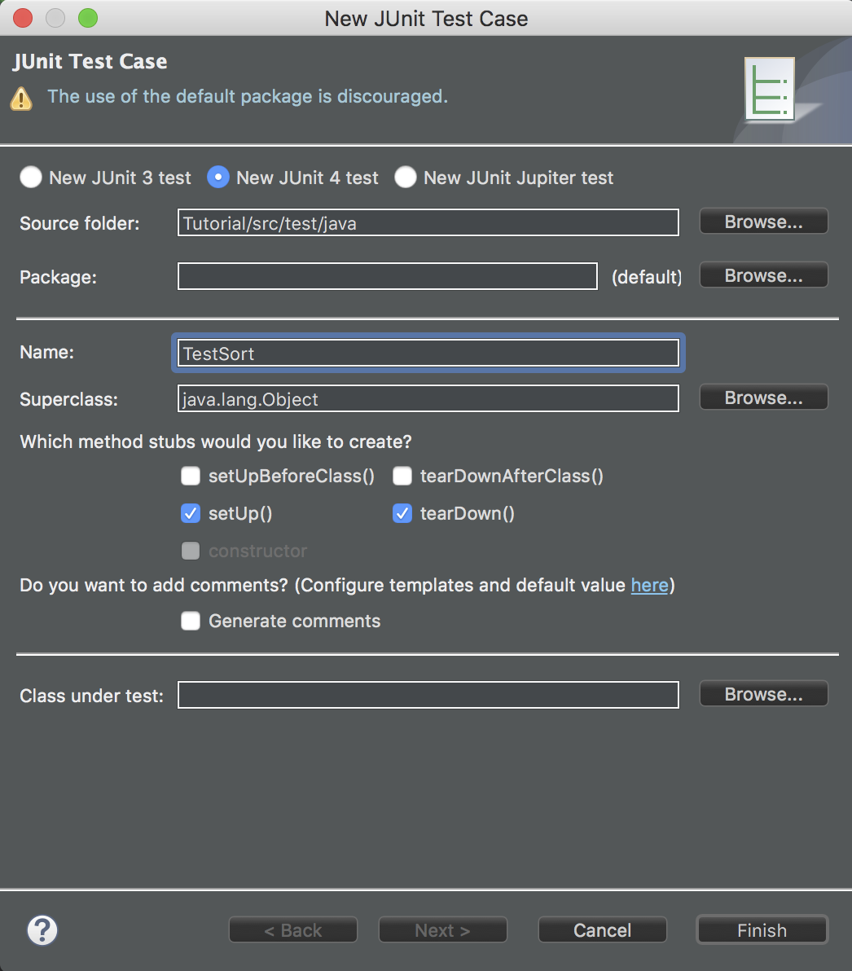
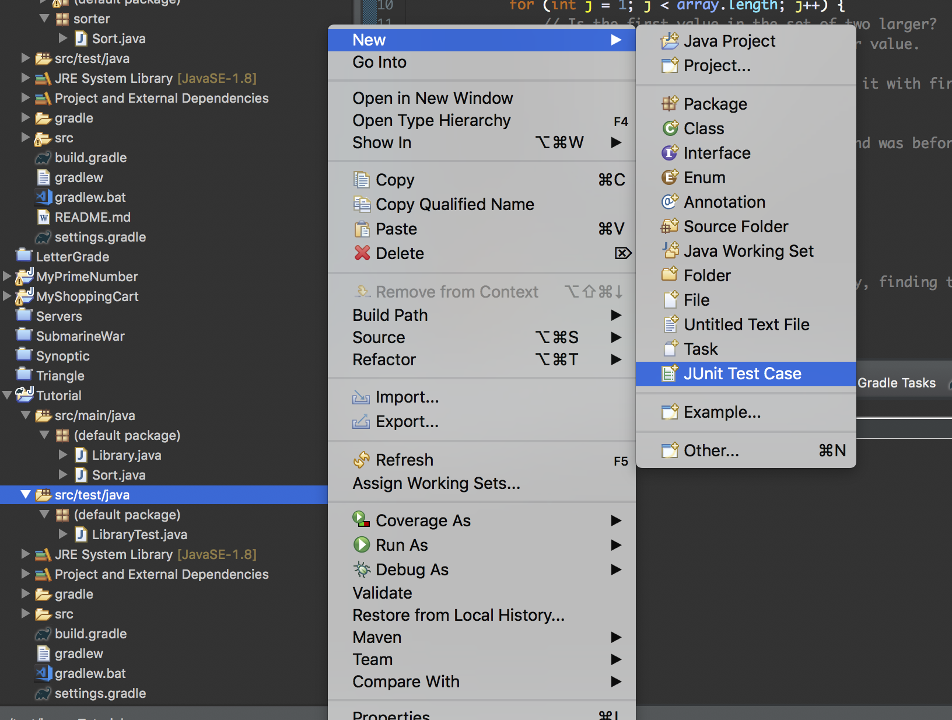
Goal 3: Writing testcases
In src/test/java >> Right click >> New >> Junit Testcase:
Create a class for test: ex. TestSort

Slide 11
Goal 3: Writing testcases
Let’s say, we’re testing on the Bubble sort algorithm
Method with decorator @Test will be executed while testing
You can import other decorator such as @BeforeClass, @AfterClass, @Ignore
See https://netbeans.org/kb/docs/java/junit-intro.html#Exercise_10
Using the external class Sort

Slide 12
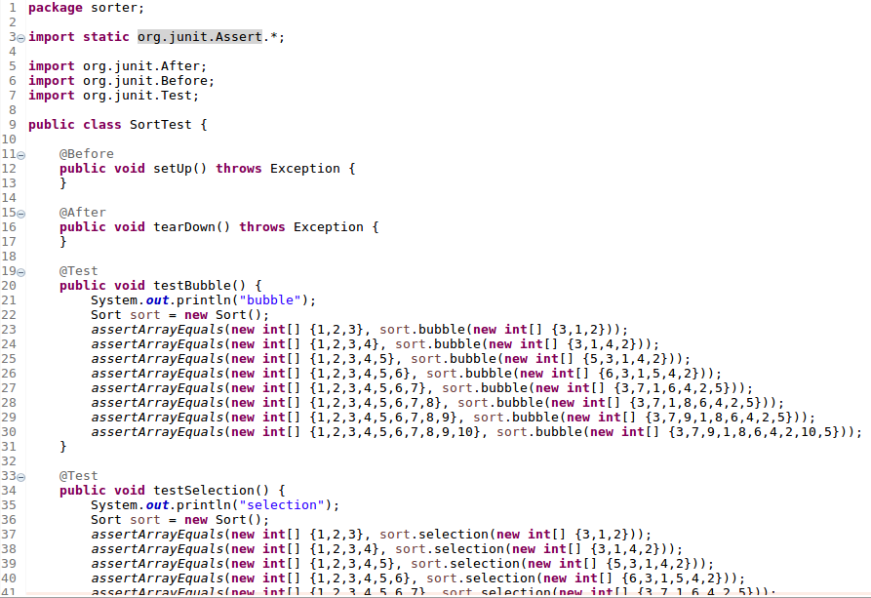
Goal 3: Writing testcases
Example

Slide 13
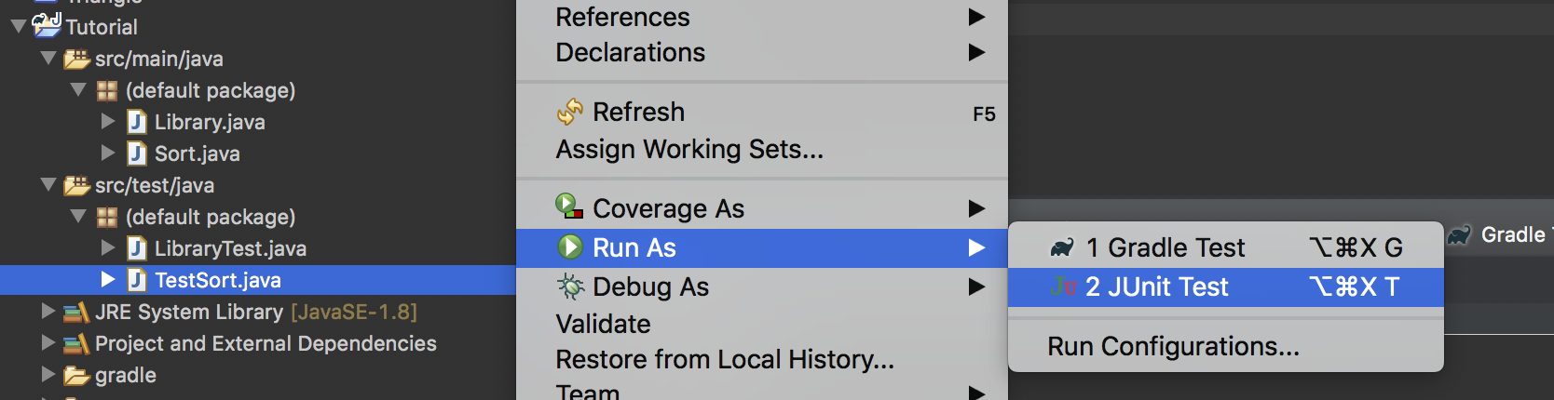
Goal 3: Writing testcases
We can run the test locally
Right click on the testing class >> Run as >> Junit Test

Slide 14
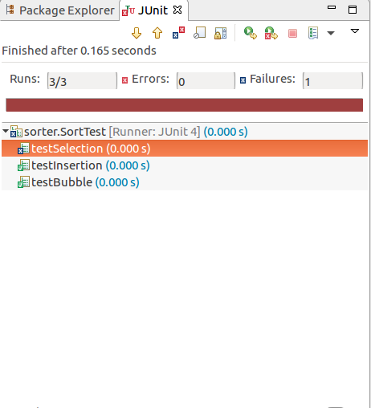
Goal 3: Writing testcases
Test Result:

Slide 15
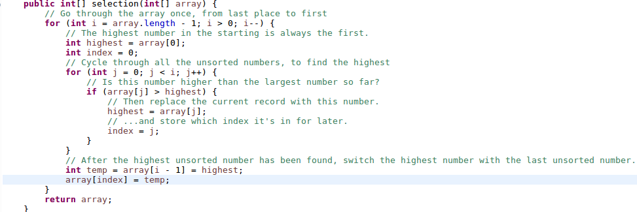
Goal 3: Writing testcases
Buggy method:

Slide 16
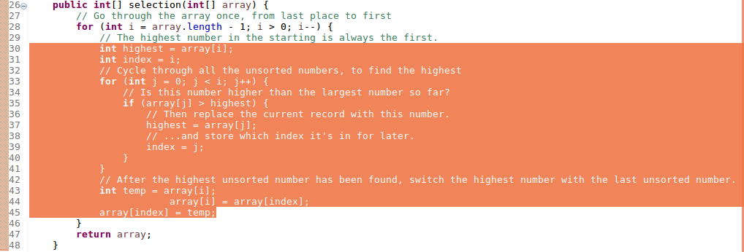
Goal 3: Writing testcases
Replaced with correct codes:

Slide 17
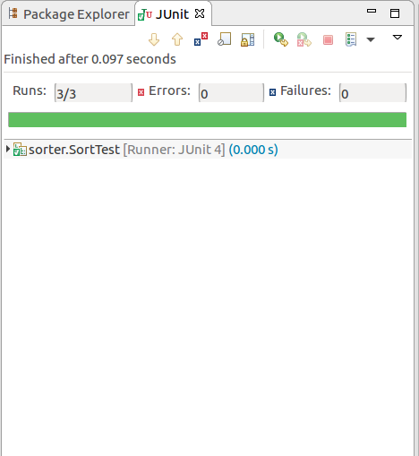
Goal 3: Writing testcases
Test result:

Slide 18
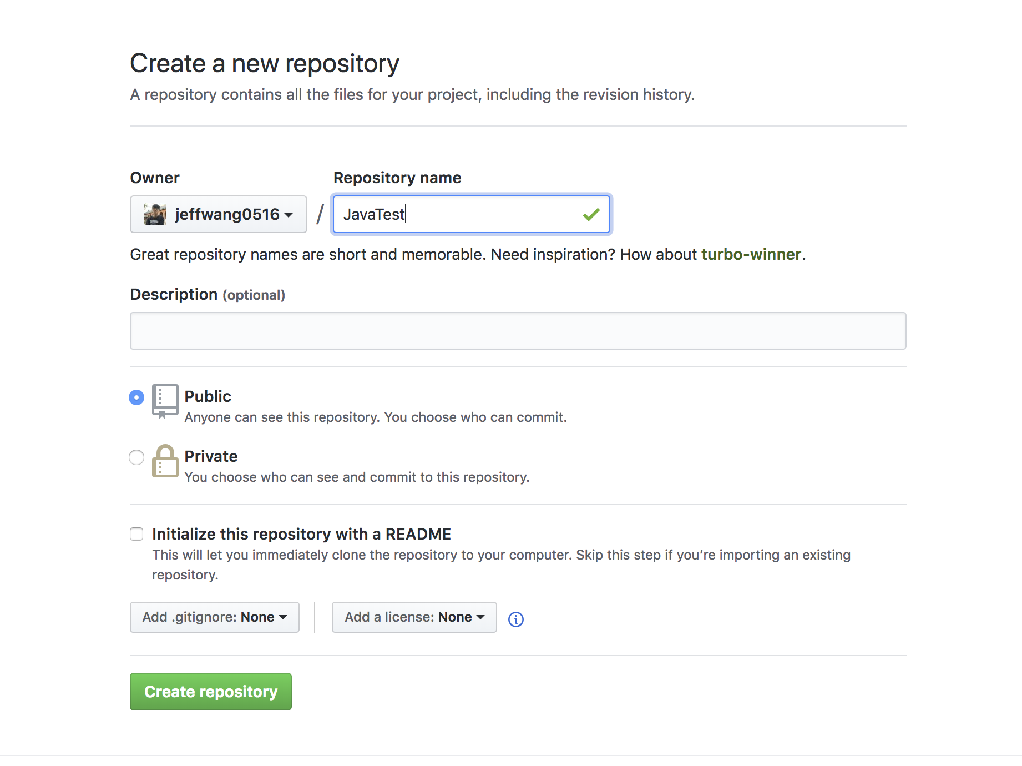
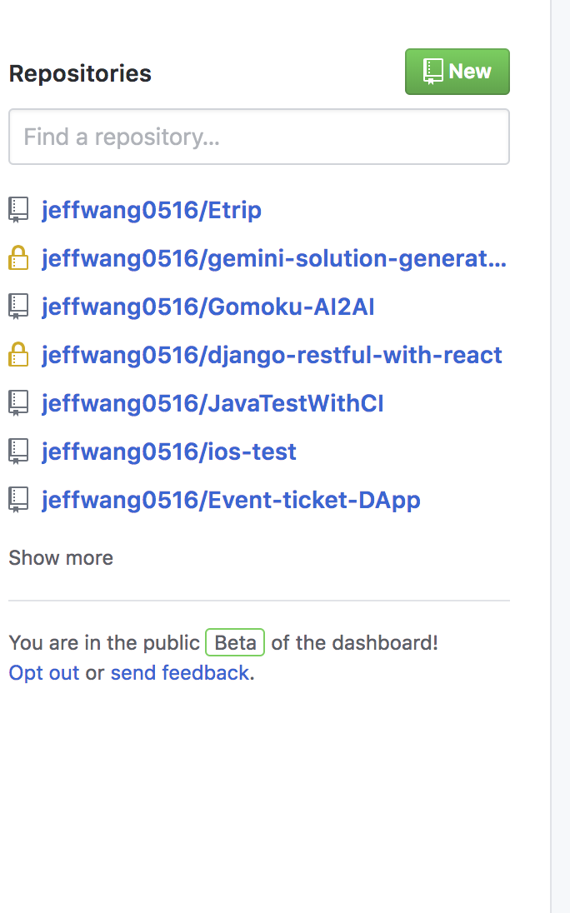
Goal 4: Create a public repo and push your work
If you do not have a Github account, register first on https://github.com/
Create a new public repo

Slide 19
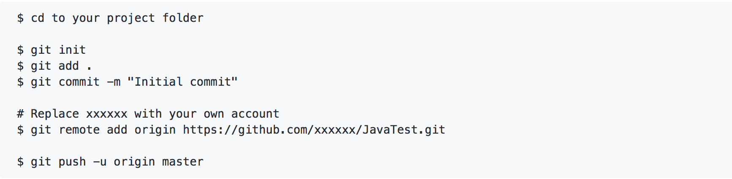
Goal 4: Create a public repo and push your work
On your terminal, cd to your project folder
If your not familiar with git: Tutorial
Sample instruction:

Slide 20
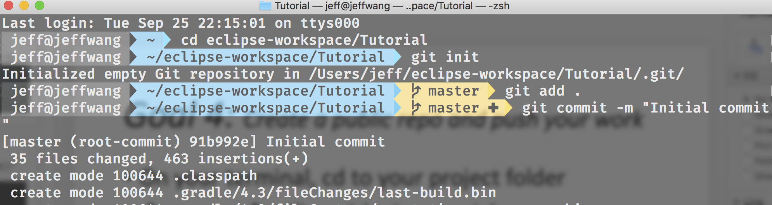
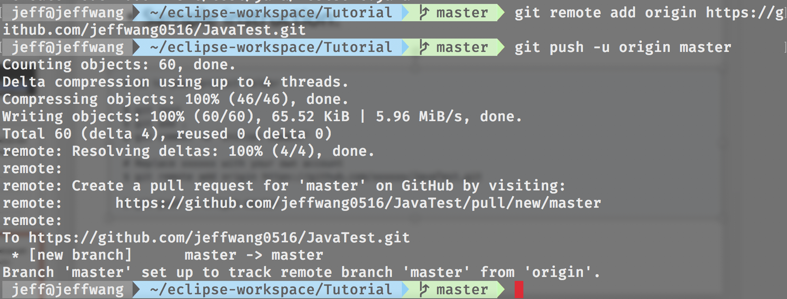
Goal 4: Terminal Snapshot

Slide 21
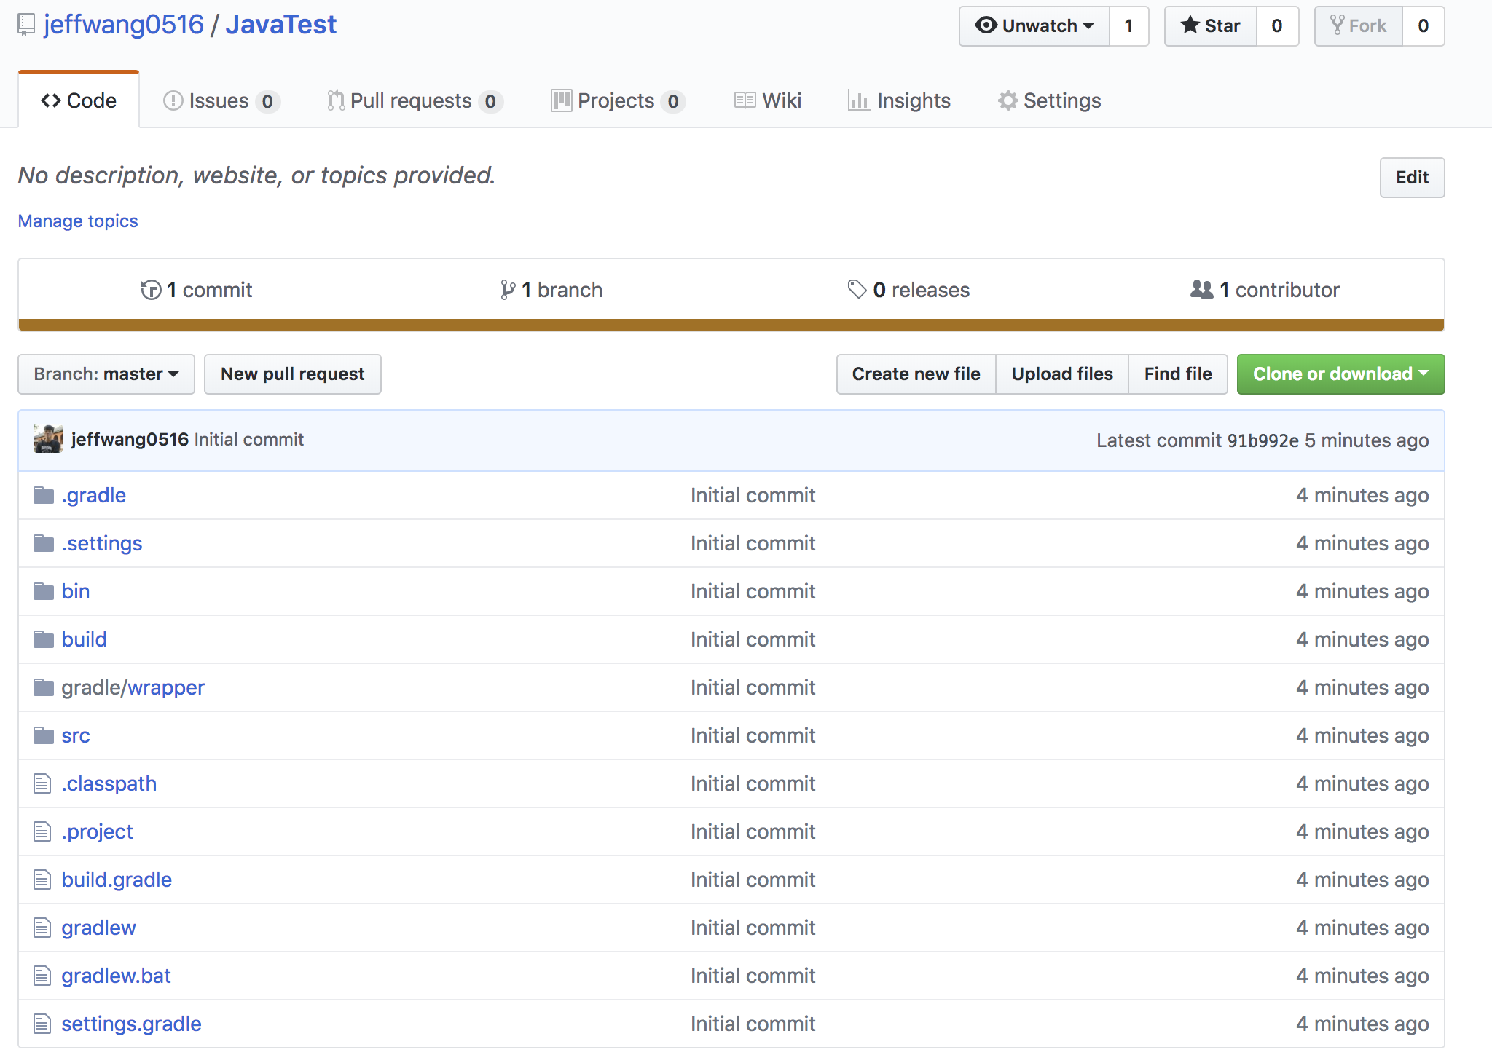
Goal 4: Create a public repo and push your work
You’re now able to see files on Github

Slide 22
Goal 5: Setup Jenkins server
Install Jenkins https://jenkins.io/download/
For Ubuntu, follow the steps here.
https://pkg.jenkins.io/debian-stable/
After finished, Jenkins service will always start at boot time and will be available at http://localhost:8080

Slide 23
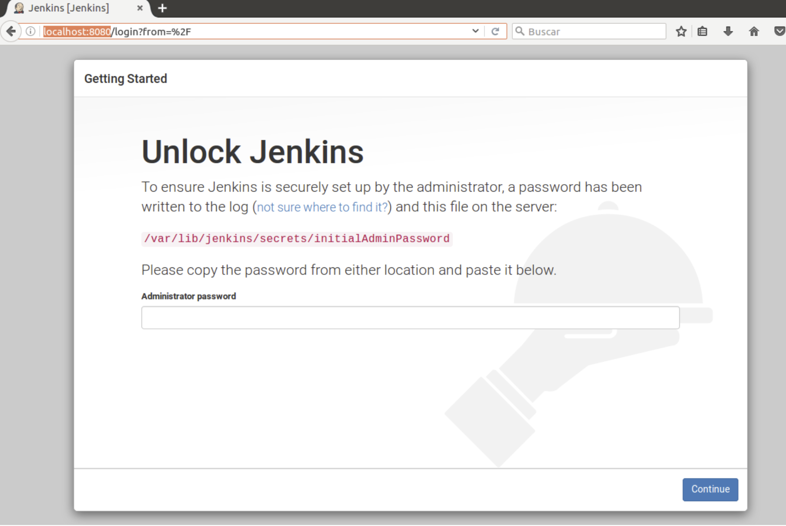
Goal 5: Setup Jenkins server
You’ll see this page for the first time
$ sudo cat /var/lib/jenkins/secrets/initialAdminPassword
Paste the code shown

Slide 24
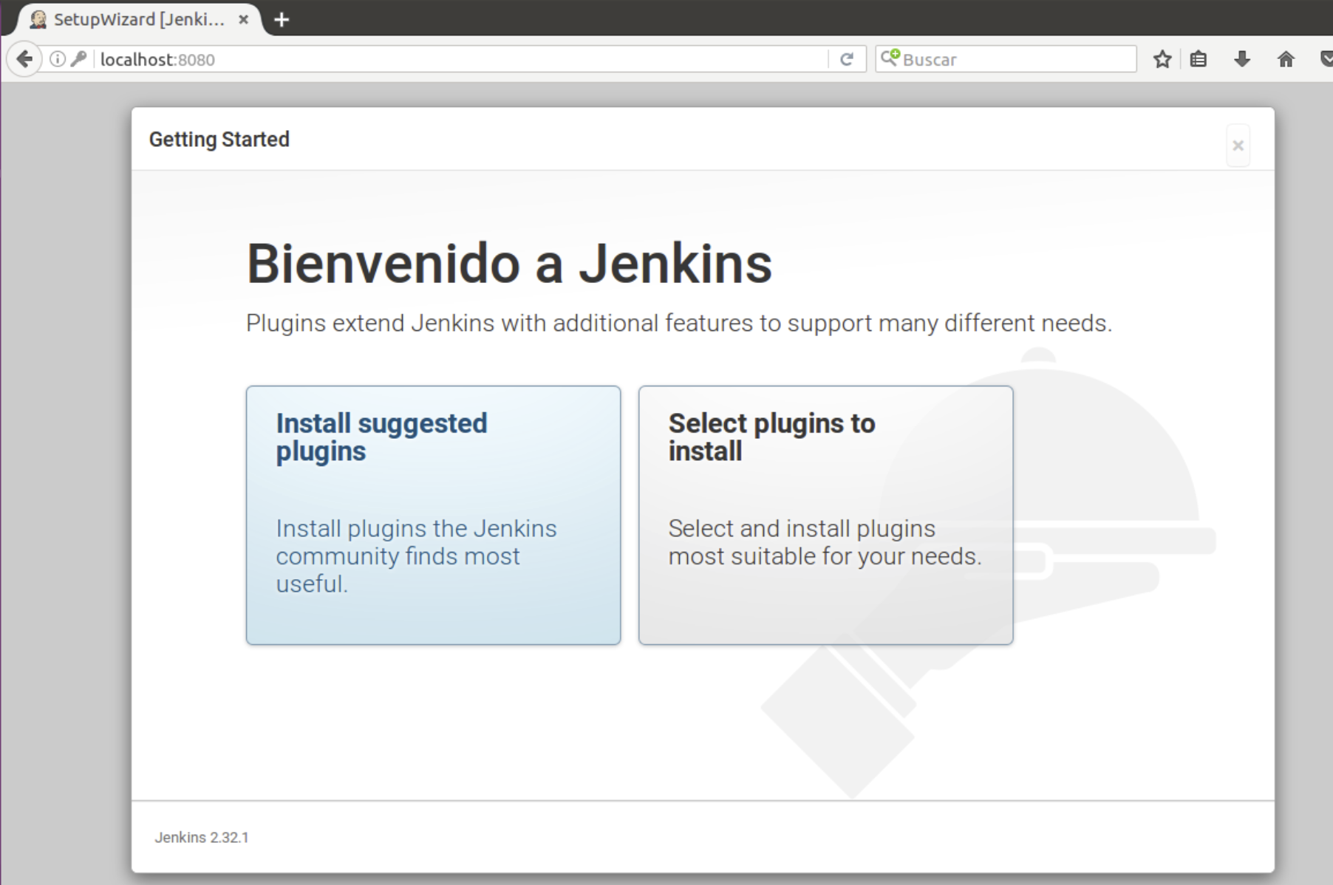
Goal 5: Setup Jenkins server
Install suggested plugins

Slide 25
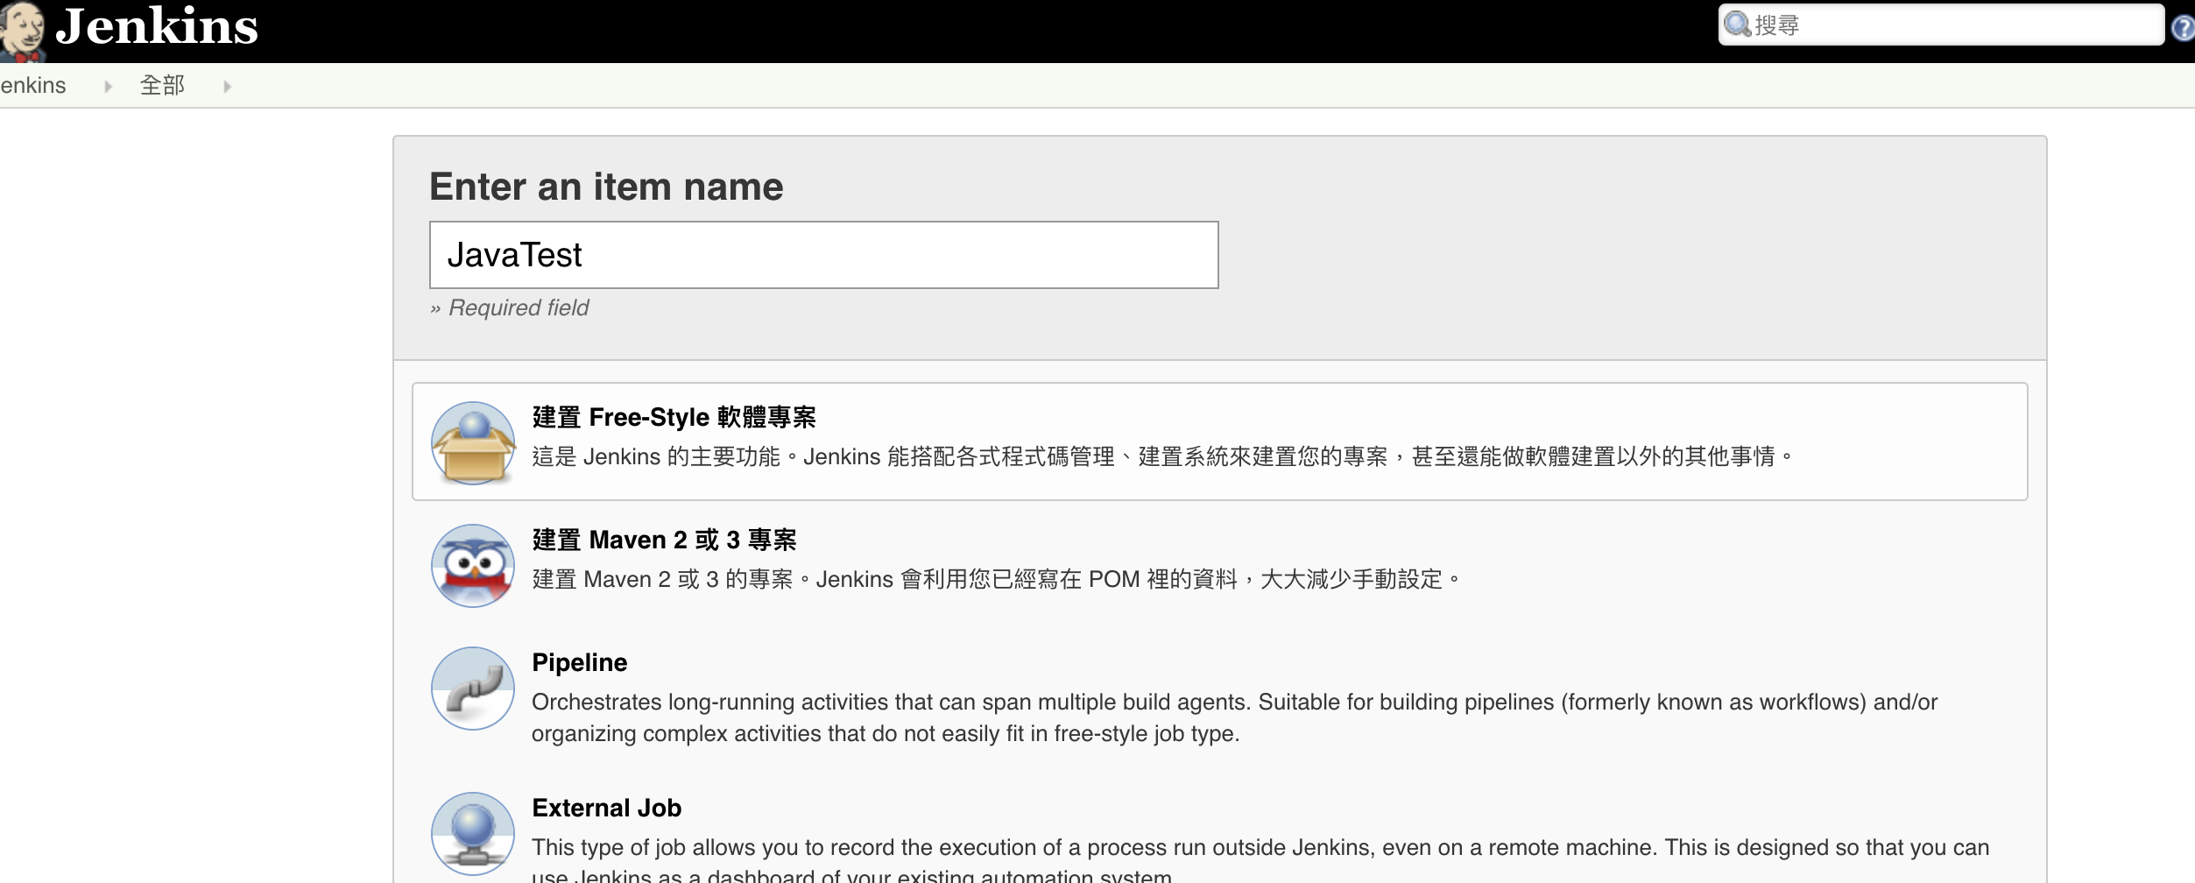
Goal 5: Setup Jenkins server
Create a Jenkins job
Select Free-style project

Slide 26
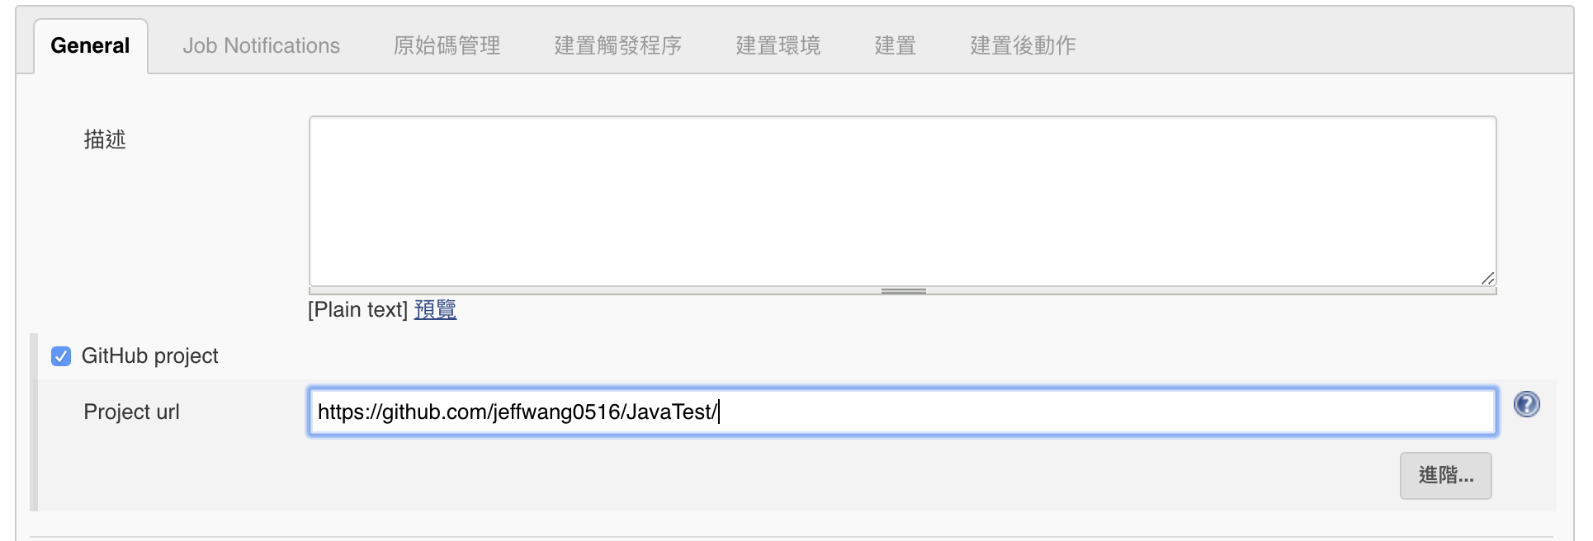
Goal 5: Setup Jenkins server
Set project url (without .git)

Slide 27
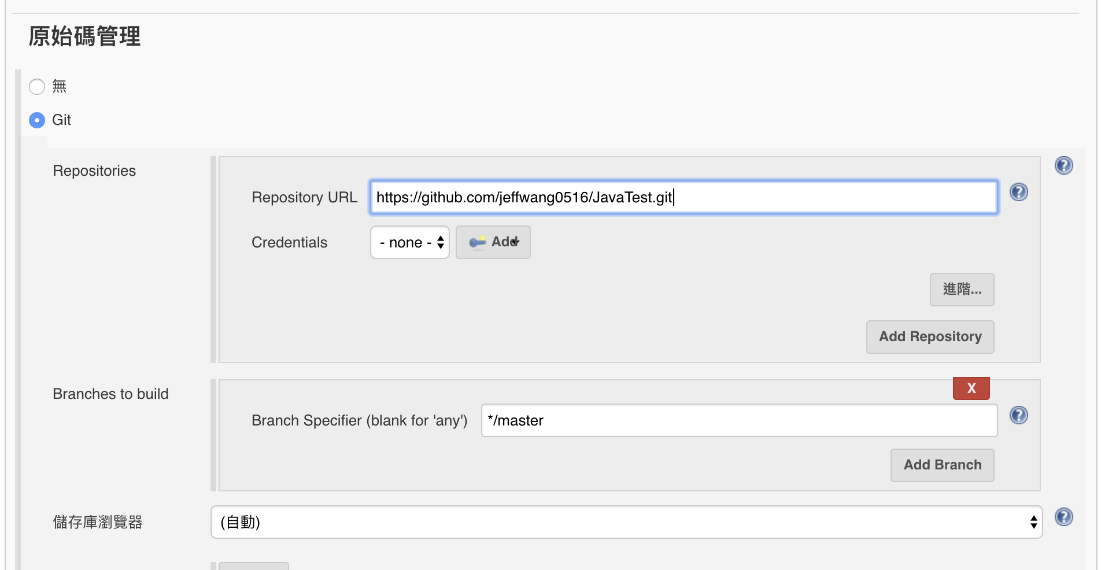
Goal 5: Setup Jenkins server
Set git repository (with .git)

Slide 28
Goal 5: Setup Jenkins server
Set git repository (with .git)

Slide 29
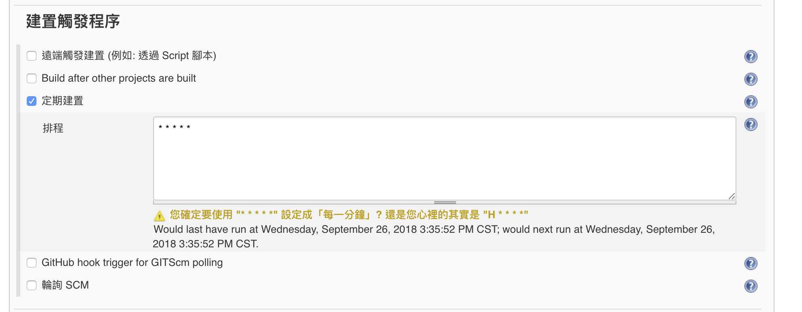
Goal 5: Setup Jenkins server
Go to “Build Triggers” section
Check Poll Scm and enter five stars with spaces (* * * * * )
It means “every minute” for cron time process. So our jenkins server will check github every minute, if there is any change in the repo it will trigger the job and tests will start. You can set trigger time however you want using cron time.

Slide 30
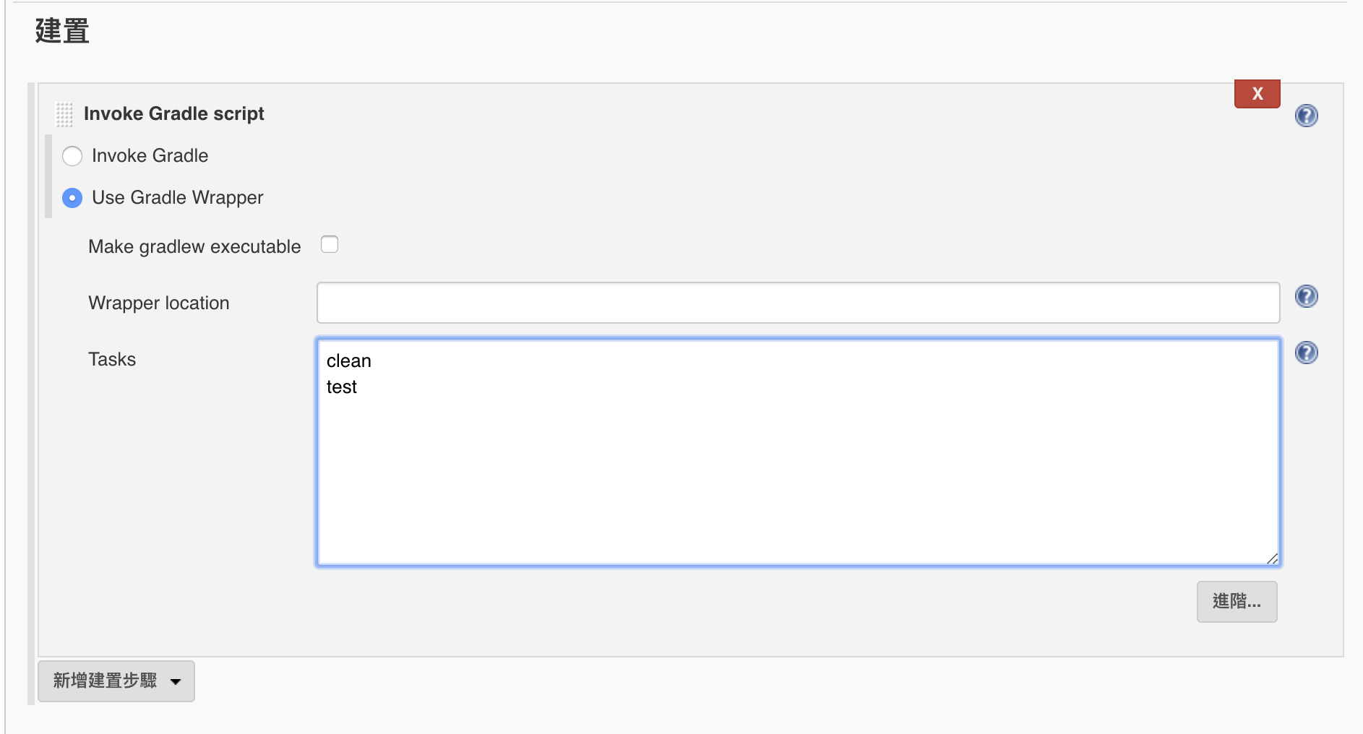
Goal 5: Setup Jenkins server
Go to “Build Options” section
>> Add build step >> Invoke Gradle script
Select “Use Gradle Wrapper”
Input the script into “Tasks”

Slide 31
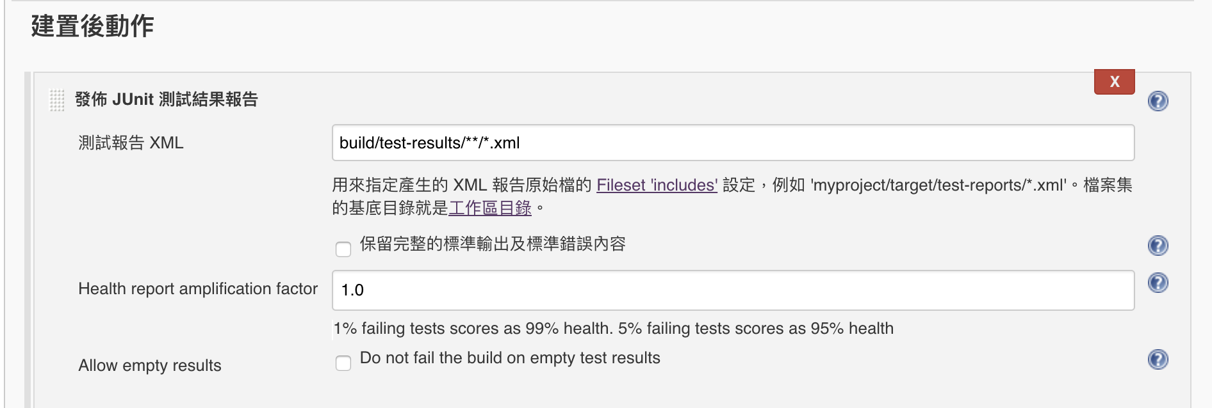
Goal 5: Setup Jenkins server
Go to “Post-Build Actions” section
Add “Publish JUnit test result report ”

Slide 32
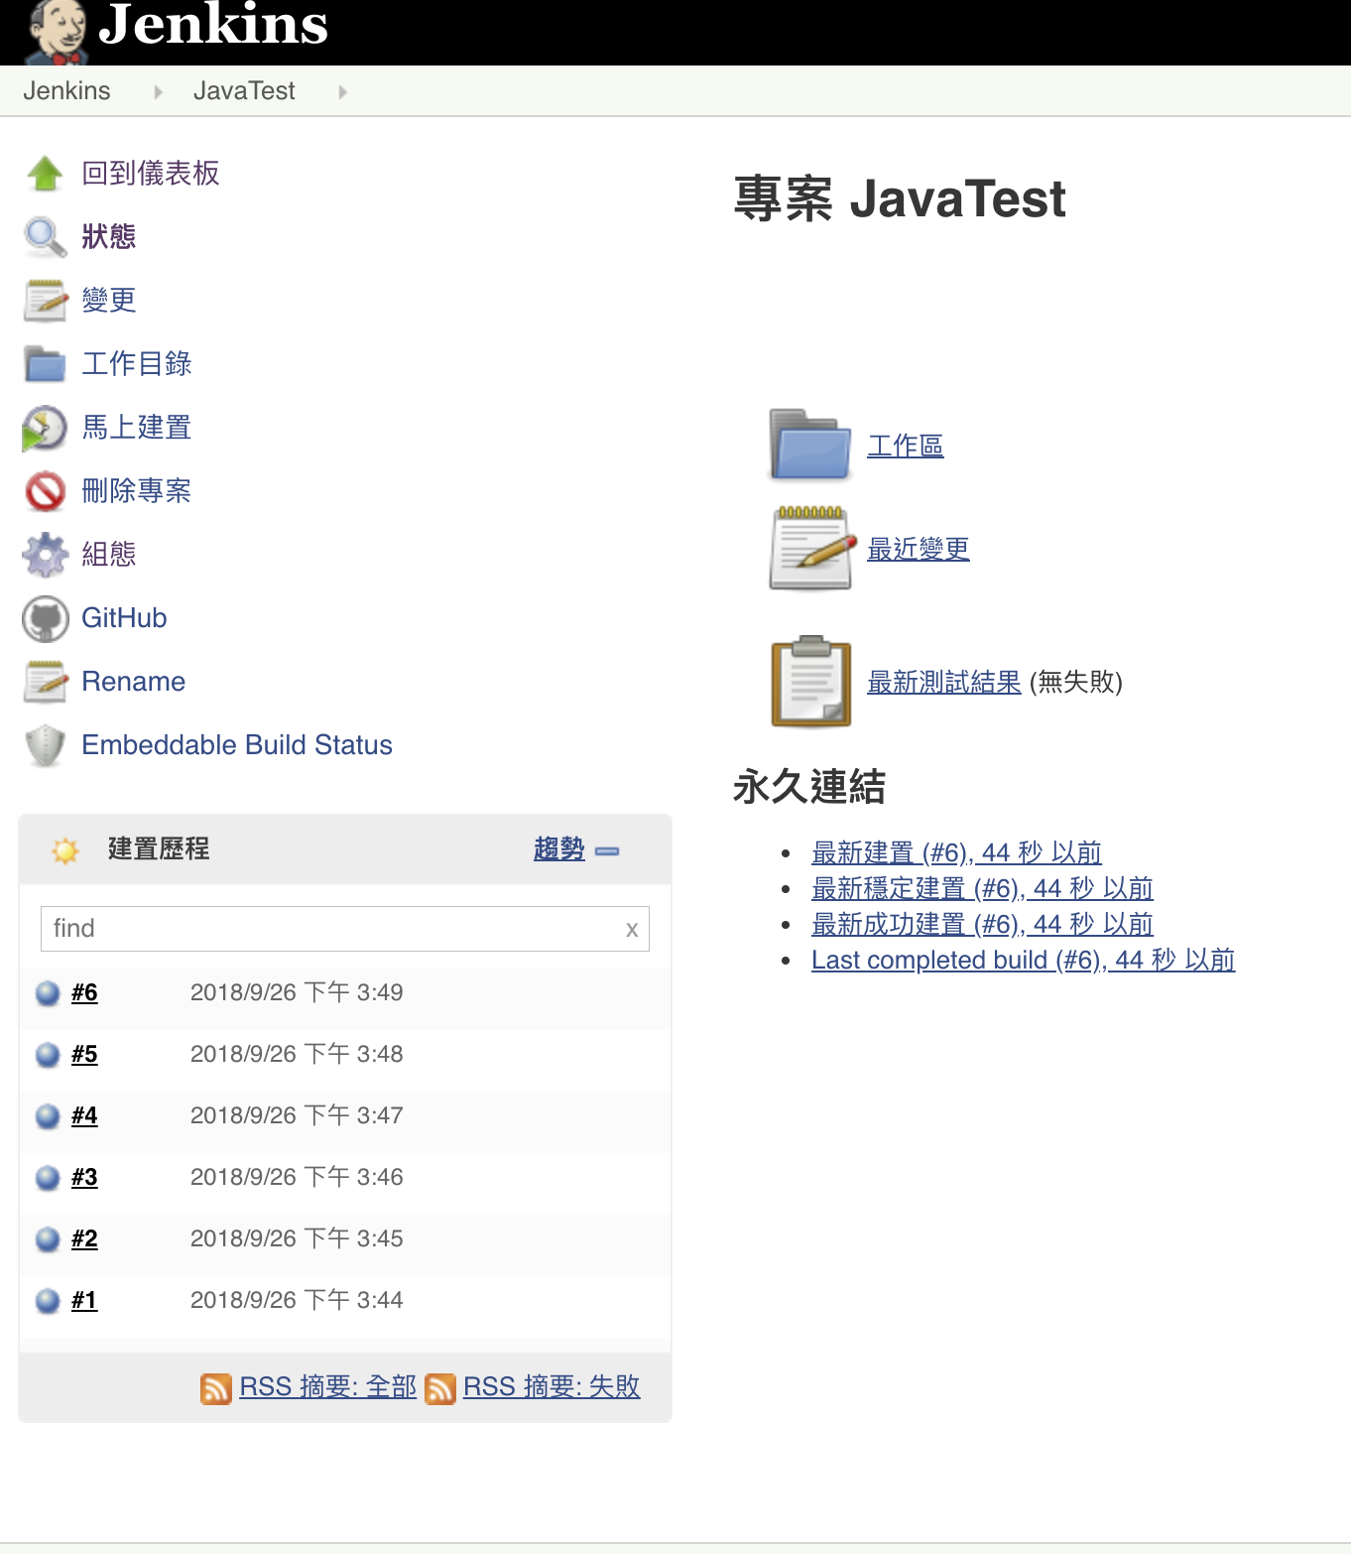
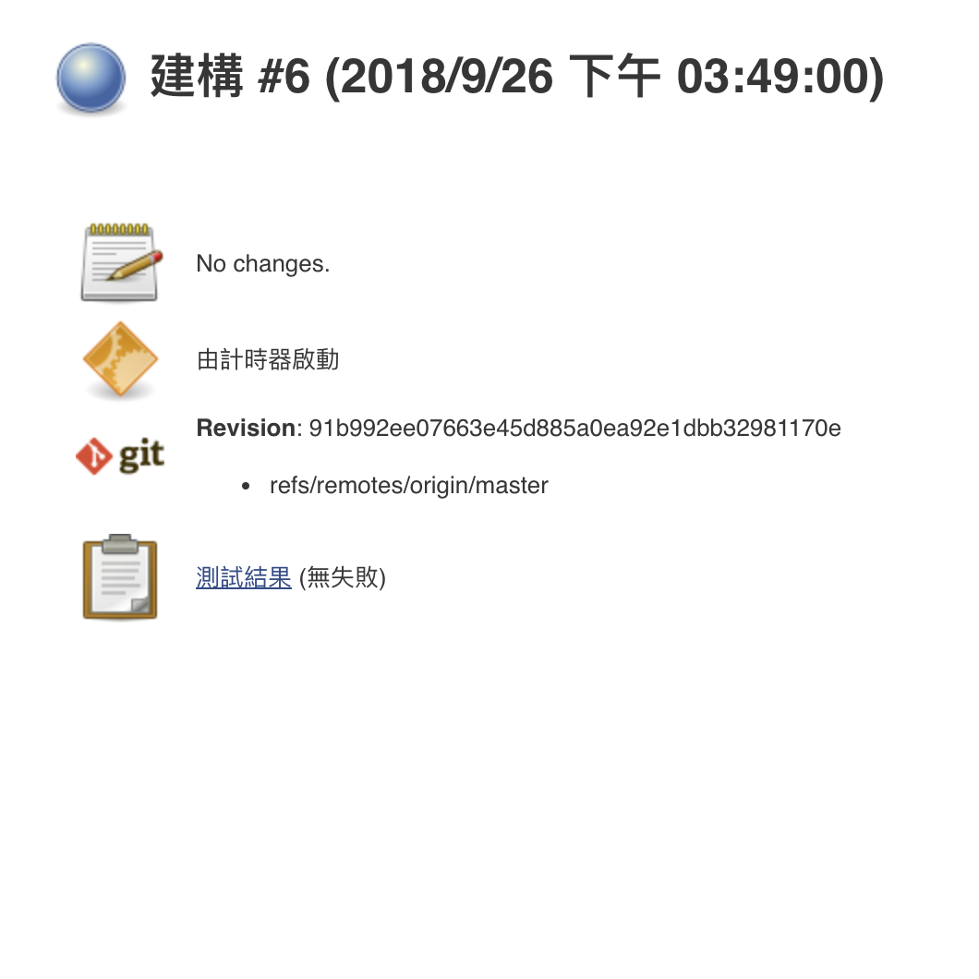
Goal 6: Automatic fetch and build your java project from Github on Jenkins
Apply the settings and your done!!!
See the build history and results
>> Click “#6” to see details

Slide 33
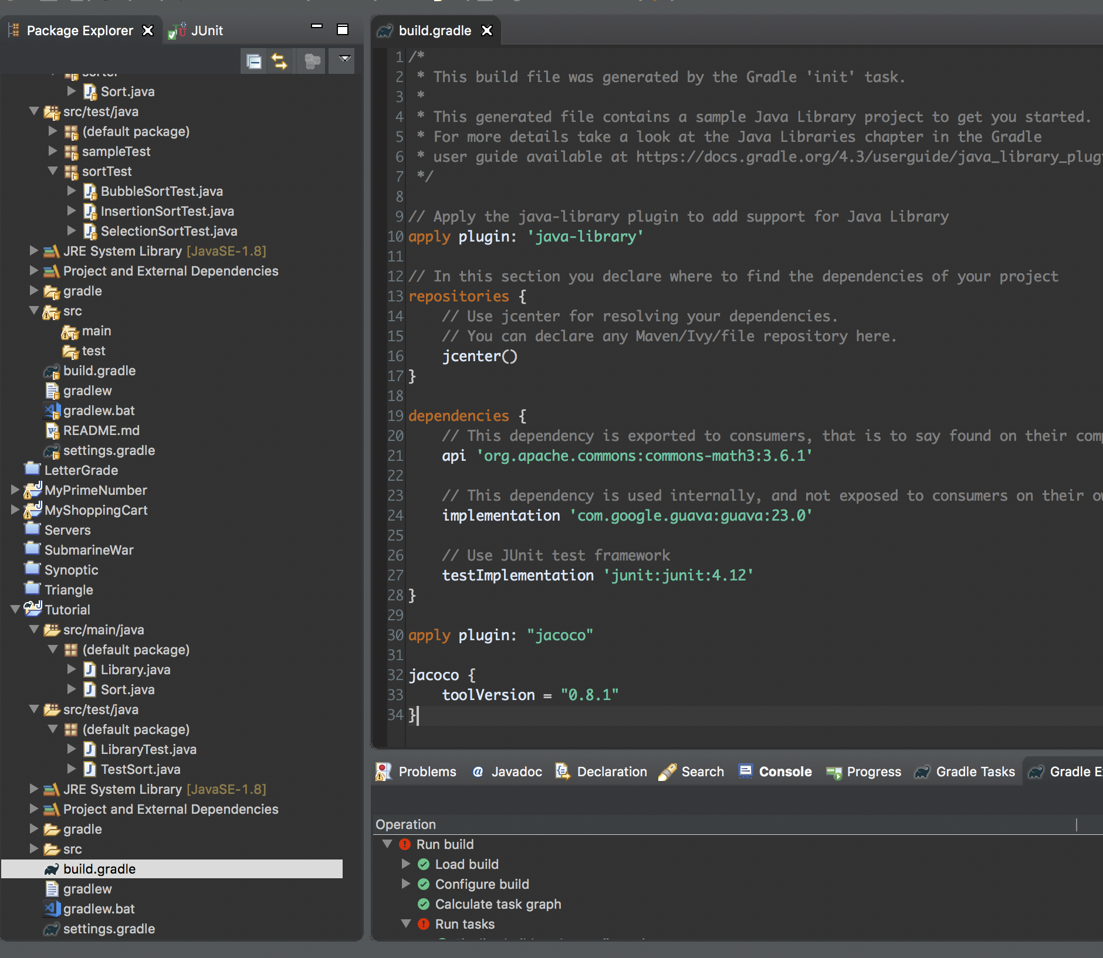
Goal 7: Coverage report with Jacoco plugin
In your project, Edit build.gradle file (Add line 30~34)
Remember to push to github after you modified your project

Slide 34
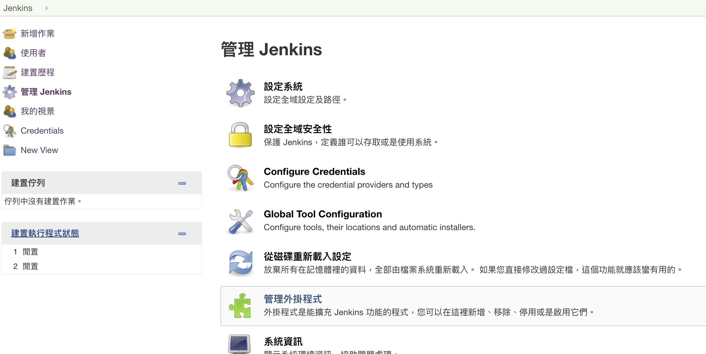
Goal 7: Coverage report with Jacoco plugin
In Jenkins, add the extension JaCoCo

Slide 35
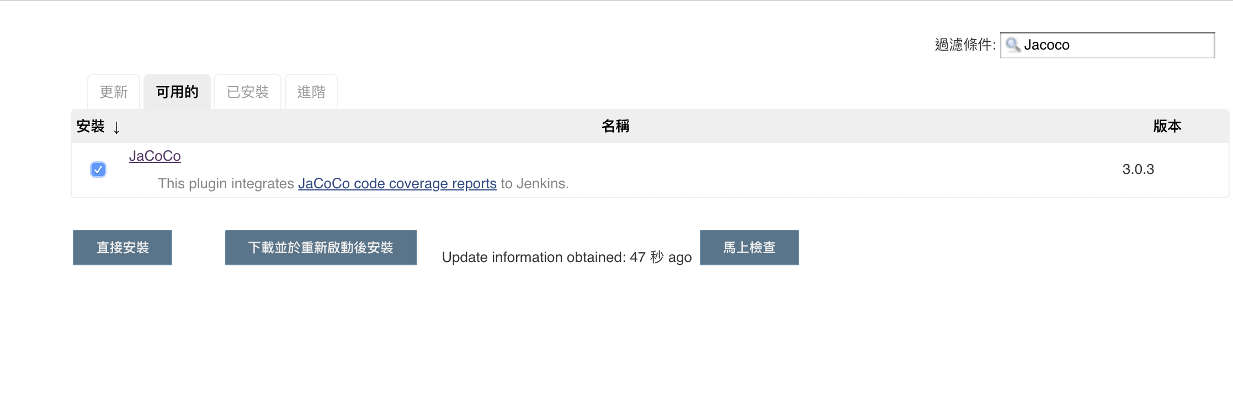
Goal 7: Coverage report with Jacoco plugin
In Jenkins, add the extension JaCoCo

Slide 36
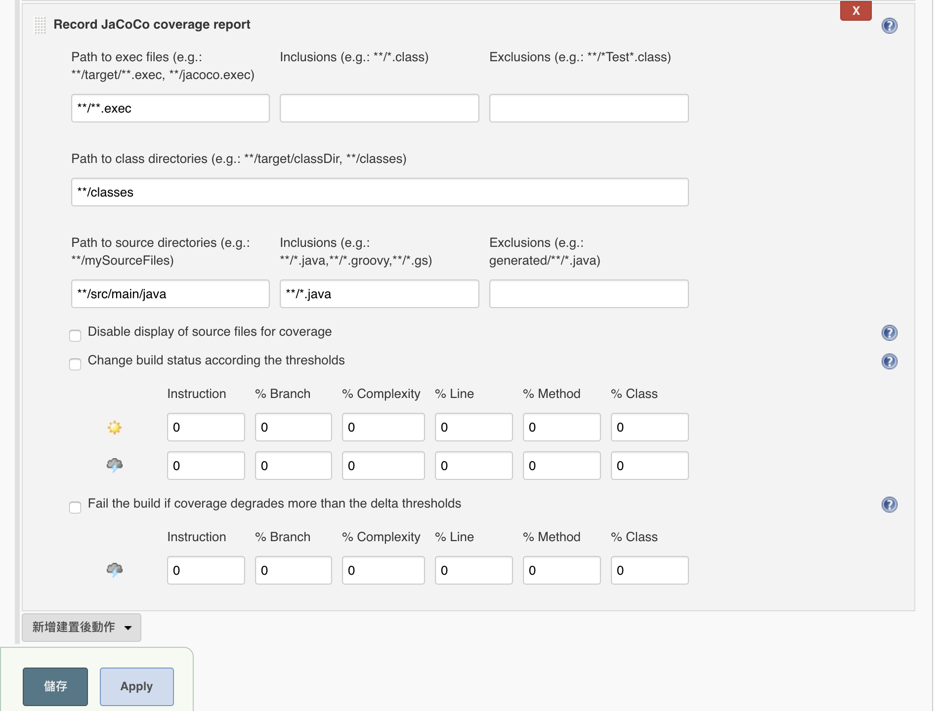
Goal 7: Coverage report with Jacoco plugin
In Jenkins project
Go to “Post-Build” section
Add “Record JaCoCo coverage report”
Apply

Slide 37
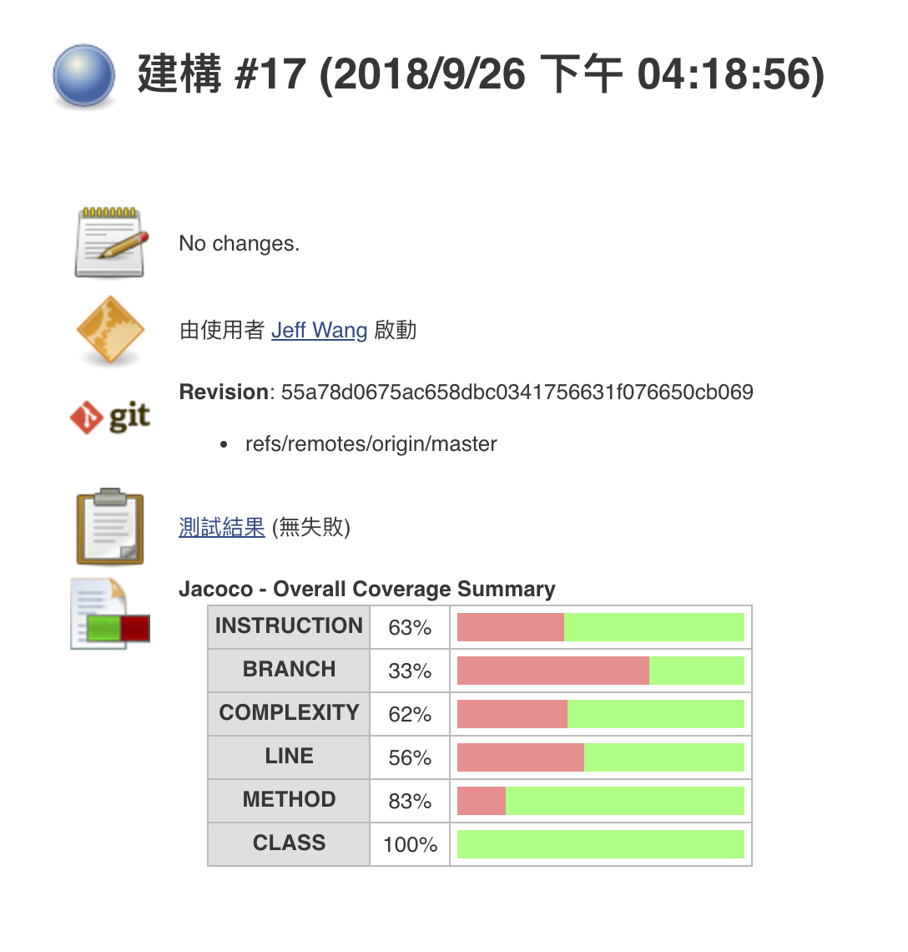
Goal 7: Coverage report with Jacoco plugin
In the next build
Extra coverage report is shown!

Slide 38
Final Goal : Find an external library and design your testcases
Find a library (ex. the Sort we use in the demo)
Create a Gradle project and write testcases
Make sure to put it on github
Automatically build and test on Jenkins!
Git tutorial: https://lee-w.github.io/git-tutorial/

Slide 39
Score
rawScore(you) = #bugs-found + line-coverage * log2(#total lines of the library SUT)
projectScore(you) = 15*rawScore(you)/(max _{anyStudent s} rawScore(s))

Slide 40
Submission
Put everything in one folder named by your student id
The folder should include:
Your Junit project Github repository URL
Screenshot of your JaCoCo coverage report
rawScore calculate yourself
Compress to .zip format
Upload to Ceiba

Slide 41
End

